Slide 1
Perkembangan Teknologi Informasi Abad 21
Onno W. Purbo
Computer Network Research Group (CNRG)
Institut Teknologi Bandung
yc1dav@cnrg.itb.ac.id.
yc1dav@garuda.drn.go.id.

Slide 2
Information Technology
Communication
Computer
Content

Slide 3
Information Technology
3C

Slide 4
Outline
Visi
Layering & Strategies in Information Technology.
Filosofi dibalik trend teknologi informasi sebuah phenomena de-facto vs. de-jure. sebuah phenomena arus bawah vs. atas.
Sisi praktis perkembangan Teknologi informasi.
Penutup

Slide 5
Objectives
Melihat beberapa sisi perkembangan teknologi informasi
Membaca Filosofi Perkembangan Teknologi Informasi

Slide 6
Visi
Mari Belajar Dari Visi Negara Lain

Slide 7
Vision
IT2000 - Vision of An Intelligent Island (Singapore) - http://www.ncb.gov.sg
National Information Infrastructure (NII) - ada banyak Web yang membawa NII.
Asia Pacific Information Infrastructure (APII).
Information Superhighway.
One Stop, Non-Stop Services.

Slide 8

Arus Atas & Arus Bawah
Sebuah Phenomena dalam Perkembangan Information Technology.

Slide 9

Pelajaran Utama
kita perlu memperhatikan secara seksama perkembangan arus bawah yang terjadi .....

Slide 10
Pelajaran Utama
Pergeseran konsep yang fundamental IT banyak terjadi justru dibawah!
contoh
Internet ...

Slide 11
Contoh Komentar Para Legendaris Arus Bawah
“Either lead or follow but please don’t block the road for those who would move forward” - Phil Karn.
“The IETF rejects presidents, kings and voting. We believe in rough consensus and working code” - David Clarke.

Slide 12

Visi Arus Bawah
Low Cost Equipments
No Regulation only Concensus
Independent Service
Distributed System
Small & Specific

Slide 13

Strategies in Information Technology
Konseptualisasi Information Technology

Slide 14
Layering of Information Technology
National IT Application
Technical
Standards
Common Network
Services
Policies and
Legal Framework
Telecommunication
Network

Slide 15
Technical Standards
Digital Media
Open Systems
Bar-coding
Smart Cards
Security
High Definition TeleVision (HDTV).
Electronic Data Interchange (EDI).
Document Representation (HTML, SGML)

Slide 16
Core Information Technology
Multimedia
Real Time Computing
Knowledge Systems
Advanced Telecommunications & Networking
Human Interface
Systems and Models

Slide 17
Principle of the NII
Distributed
  'Middleware' such as APIs, RPCs, and Messages
Ubiquitous
  Information Appliances and Utility
Reliable
  Fault Tolerance, Distributed Systems, DCE
Secure
  Communications, Data and User Access Security

Slide 18
Principle of the NII
Multi-service
  Bandwidth on Demand - Gigabit Networks
Easy to Use
  Ergonomics and Multilingual Characters
Open
  Standards for Interoperability, Portability, Integration

Slide 19

Let’s see Singapore
One of my favorite!

Slide 20
Singapore’s IT Milestones
IT 2000
Informatisation
1992
National IT Plan 1986
National Computeriztion Plan 1980

Slide 21
Singapore’s National IT Plan
IT Manpower
IT
Application
IT Culture
Coordination
Collaboration
Information Communication
Infrastructure
IT
Industry
Climate for Creativity &
Entrepreneurship

Slide 22
IT2000
Vision of an Intelligent Island
Information Appliances
Accessing
Rich Array
of Multimedia Services
IT links Computers
In Every Home, Office,
School, Factory,
and Government ...
Advanced National
Information
Infrastructure
Smart Infrastructure
- Ports, Schools,
Roads

Slide 23
IT2000 Sectoral Group
Tourist & Leisure Services.
Transportation.
Retail, Wholesale & Distribution.
Construction & Real Estate.
Education & Training.
Financial Services.
Media Publishing & Information Services.
Manufacturing.
IT Industry.
HealthCare.
Government

Slide 24
Some Singapore’s Initiatives
Trade-Net
Establishment of Data Hubs.
Student’s & Teacher’s Workbench.
Internet for Schools.
Construction and Real Estate NETwork.
Legal Services - Court Vision 21.
Helthcare MediNet
Electronic Road Pricing (ERP)
TourNet
Borderless Library Network.

Slide 25
Singapore’s TradeNet
Customs.
Wholesalers.
Distributors.
Retailers.
Importers / Exporters.
Freight Forwarders.
Shipping Agents.
Carriers.
Transport Companies.
Banks.
Information Providers.
Insurance Companies.
Air Cargo Agents.
Other Gov’t Agencies.

Slide 26

Tradenet’s Performance
SIM Award 1989.
20 Gov’t Agencies.
8500 Companies.
95% electronic submission.
Approval reduced from 2 days to 15 mins.
20-30% increase in user productivity.
24 hour operation.

Slide 27

TradeNet Key Factor.
Human Resource.
Electronic Data Interchange (EDI).

Slide 28
Singapore’s Data Hub
Land Hub
  Physical land-related data including lot boundaries, buildings, utilities, roads.
Estab Hub
  Business information like name, registration number, paid-up capital, directors information.
People Hub
  Personal data like name, NRIC, address, sex, date of birth etc.

Slide 29
Data Hubs Benefits
Reduced effort in data collection and processing.
Minimise redudancy and duplication of data storage.
Less of a bother for the citizen to fill up common information already known.
More timely, accurate and consistent data.

Slide 30

User’s Perspectives
Arah Perkembangan di Bawah
(arus bawah)

Slide 31
Demand Push
High Speed
  2Mbps WAN is bare minimum!
Video / Multimedia Applications
  Virtual Reality is one of the ultimate goal!

Slide 32

Konsekuensi Teknologi
Application Specific
Personal Interaction - Multimedia

Slide 33
Trend Communication Technology
High Speed Clear Channel
atau
Small High Speed Packet

Slide 34

Apa yang di inginkan user?
High speed & low cost!
Tidak harus B-ISDN / ATM / E1 / T1
dkk dll .....

Slide 35
Arus Bawah Memilih
High Speed Clear Channel
(low cost!)

Slide 36
Konsekuensi Lain
High Speed Switching Router

Slide 37

Trend Computer Technology
Small
Low Cost
Application Specific

Slide 38

Bisa kita Perhatikan
Mainframe vs. Personal Computer.
RISC Processsors.
Palmtop application specific computing devices .....

Slide 39
Apa yang di inginkan user?
High speed & low cost!
bukan multi-purpose devices.
rela membeli banyak cheap / low cost application specific appliances.

Slide 40
Trend Content
Multimedia
Interactive

Slide 41
Apa yang di inginkan user?
Live Personal Communication
& information retrieval

Slide 42
Hal lain yang diinginkan ..
Network Security!

Slide 43

Cukup dengan Filosofi
Get real!

Slide 44

Teknologi Komunikasi
Clear Channel High Speed

Slide 45
Contoh Nyata Teknologi
Komunikasi
Wireless Wide Area Network
Teknologi HDSL & sebangsanya.
Multicast Backbone (MBONE)
100Mbps Ethernet

Slide 46
Peralatan Wireless WAN
Card Wireless Ethernet
Speed 2Mbps s/d 10Mbps
Distance 15-40 km :-) ....
Antenna Yagi / Disc
PC sebagai router ke LAN Ethernet

Slide 47
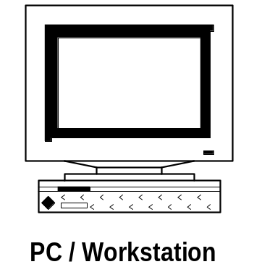
Wireless LAN
PC dengan spesifikasi:
386
4Mbyte RAM
Cukup Floppy
Ethernet card ke LAN

Slide 48
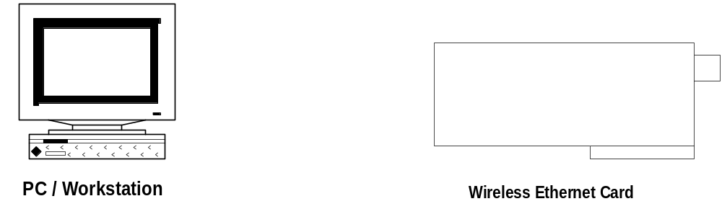
Wireless LAN
Spec. 250mW
915MHz / 2.4GHz
2,048Mbps
Teknologi CDMA
US$750 / buah

Slide 49
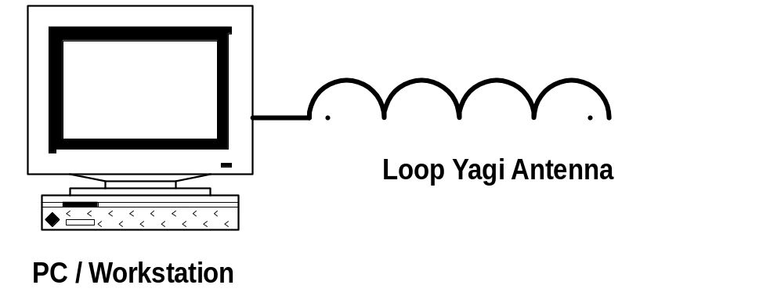
Wireless LAN
Antenna Loop Yagi
915Mhz
Rp. 100.000,-
Disc 2.4GHz

Slide 50
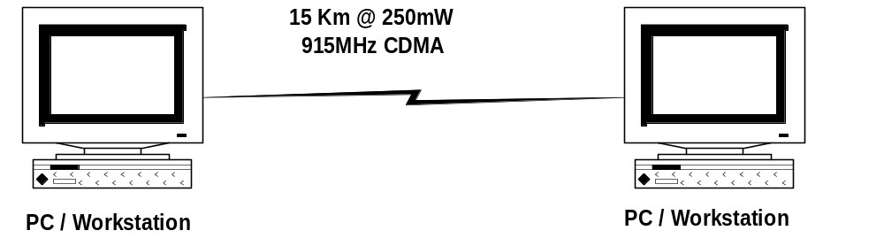
Wireless LAN
Percobaan di ITB, Bandung
Dengan Antenna Loop Yagi 915MHz
Jarak 15 km LAN-to-LAN Connection 2Mbps
(sponsor PT. Compact Microwave Indonesia)

Slide 51
Mungkinkah Membuat Sendiri
Wireless LAN Equipments?
Sangat Mungkin!
Chip Set CDMA Cellular banyak dipasaran ....

Slide 52
Bagaimana Dengan Regulasi?
MenParPostel belum mempunyai regulasi tentang CDMA ....
Peluang untuk melakukan penelitian & perubahan regulasi untuk CDMA di Indonesia

Slide 53
Teknologi HDSL
Modem HDSL
Speed 2,048Mbps
Distance 5 km via chopper wire
PC dengan Interface card / Router

Slide 54
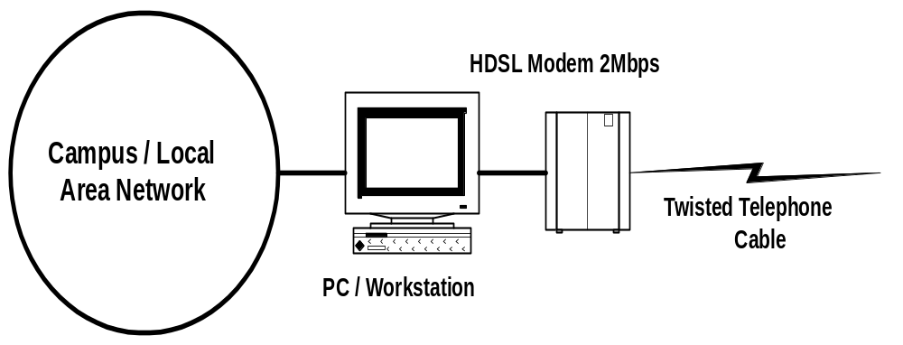
HDSL Equipment

Slide 55
Konsep Multicast Backbone
IP address MBone 224.0.0.0
Client akan “monitor” pada IP address MBONE.
Menggunakan software switching
  mrouted

Slide 56
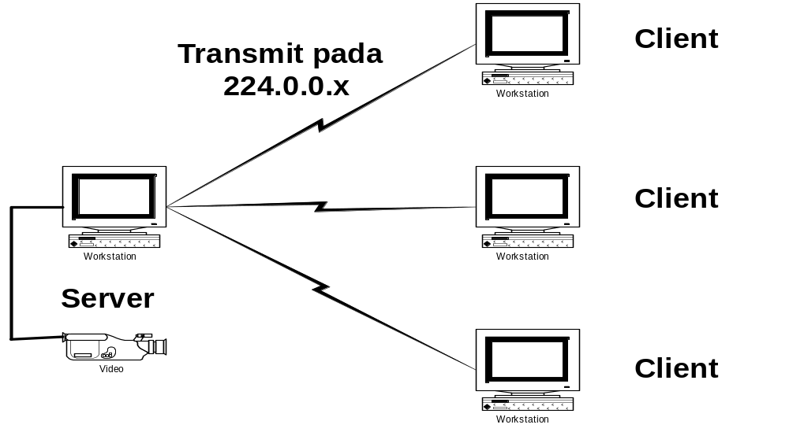
Visualisasi MBONE

Slide 57
Aplikasi MBONE
Video Broadcasting via Internet
TV Broadcasting via Internet
TV Reflector di Internet
Video Teleconference via Internet

Slide 58

Teknologi Komputer
Application Specific Computing Devices

Slide 59
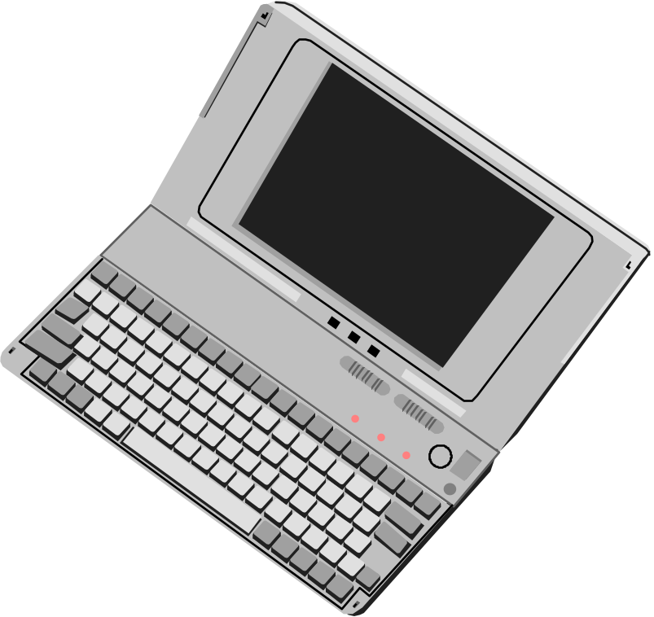
Contoh Nyata
Internet Toaster US$500 :-) ....
Processor + 4Mb RAM + Modem - US$250 ...

Slide 60
Argumentasi Intel
Visi “The Connected PC”.
Reduced Microprocessor Price.
Imbedded Multimedia.

Slide 61
Content
Interactive Multimedia
Network Security

Slide 62
Contoh Nyata
Java & HotJava
CU-see-Me
(Video Conference)
Virtual Reality Modelling Language (VRML)

Slide 63
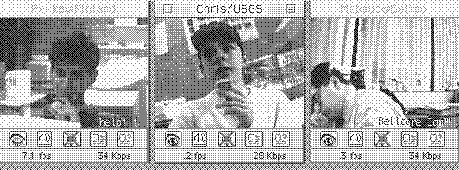
CU-see-Me

Slide 64
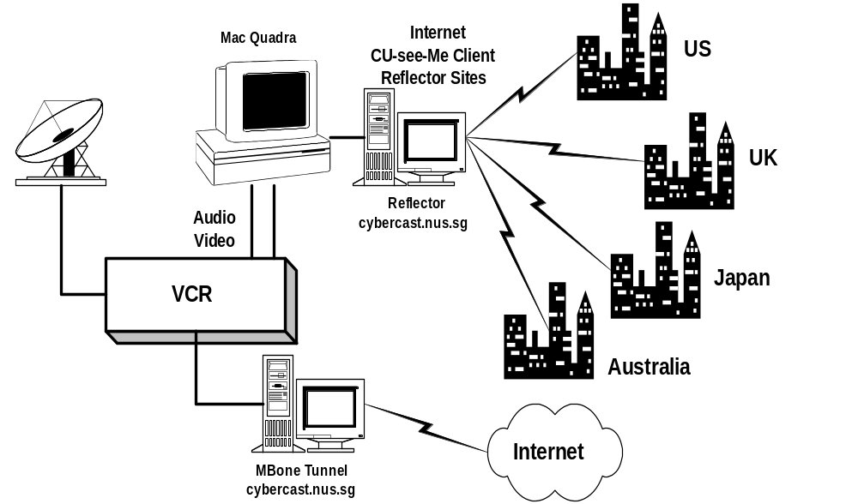
Cybercast Station
http://www.nus.sg/Cybercast/Cybercast.html

Slide 65
Cybercast Station
Satellite / Microwave Disc
For Receiving Broadcast
Transmission
http://www.nus.sg/Cybercast/Cybercast.html

Slide 66
Cybercast Station
http://www.nus.sg/Cybercast/Cybercast.html
VCR to remove the RF signal
and split video & audio signals

Slide 67
Cybercast Station
http://www.nus.sg/Cybercast/Cybercast.html
MacQuadra sebagai server
CU-see-Me

Slide 68
Cybercast Station
Reflector / Relay24 jam
Bagi trsnsmisi video
http://www.nus.sg/Cybercast/Cybercast.html

Slide 69
Cybercast Station
http://www.nus.sg/Cybercast/Cybercast.html
MBone Tunnel
untuk transmisi via
Firewall / Internet

Slide 70
Some Cool URLs in Internet
http://irdu.nus.sg/vrml/ VRML site
http://irdu.nus.sg/hotjava/ HotJava Web site
http://nusinfo.nus.sg:80/Major/vod.html Video on Demand

Slide 71
High Profit IT Business
Human Resource
Manufacturing backed by Research & Development

Slide 72

Bagaimana dengan Indonesia?
Sekelumit R&D di ITB

Slide 73
Sekelumit kegiatan R&D ITB
NOC untuk Bandung-Net.
2Mbps Ku-Band gate ke Asian Internet Interconnection Initiative / AI3 (Nara, Japan).
38.4Kbps L-Band gate ke Partners gateway (Kashima, Japan).
HDLC Card 64-256Kbps.
GMSK 19.2Kbps & 64-256Kbps modem.
DSP based modems (support Motorola International Inc).
Terminal Node Controllers untuk packet network.

Slide 74
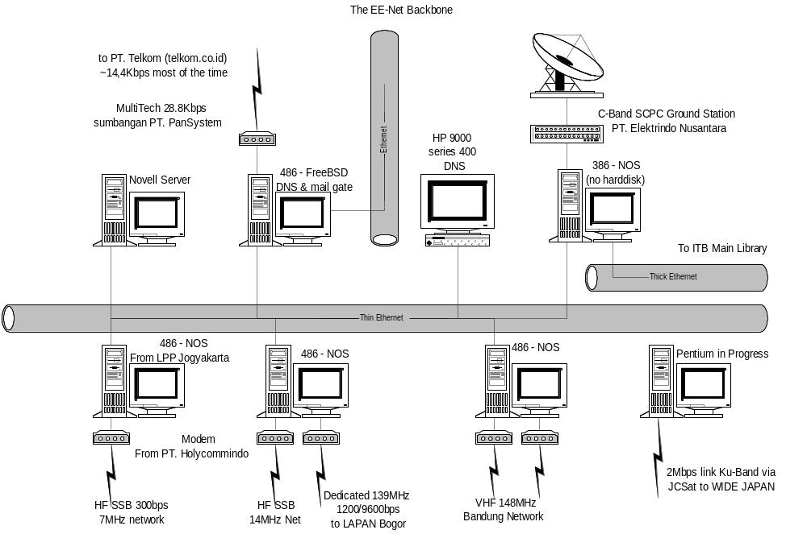
Network Center - CNRG-ITB

Slide 75
Kerjasama / Sponsored R&D
38.4Kbps C-Band gate ke PT. Elektrindo Nusantara.
Leased line 28.8-14.4Kbps via MultiTech & Motorola Vanguard 300 (PT. Telkom, PT.PanSystem & PT. Abhitama Citra Abadi)
Operasi 9 gateway radio (7 VHF & 2 HF) - (partly PT. Hollycommindo Hitech).
Operasi 2 link 2Mbps WaveLAN (PT. Compact Microwave Indonesia)

Slide 76
Beberapa Obsesi CNRG-ITB
Running an Indonesian MBone Tunnel & Reflector Site.
Running CU-see-Me Teleconference site (butuh videoblaster + multimedia kit).
Build 2-10Mbps Wireless Equipments.
Build 2Mbps HDSL modem & interface.

Slide 77
Summary
Human Resource would be the key to success.
Belajar dari pergerakan arus bawah di Information Technology.
Belajar dari pergerakan National Information Infrastructure - antisipasi market shift.

